Slide 1
Employee Data Analysis using Excel
STUDENT NAME:R.Kousalya
REGISTER NO:122203999
DEPARTMENT:B.com (CS)
COLLEGE Shri krishnaswamy college for women

Slide 2
PROJECT TITLE
Employee Gender Analysis using Excel

Slide 3


AGENDA
Problem Statement
Project Overview
End Users
Our Solution and Proposition
Dataset Description
Modelling Approach
Results and Discussion
Conclusion
3/21/2024 Annual Review

Slide 4

PROBLEM STATEMENT
t:*
"As a human resources analyst, I need to analyze the gender distribution of our company's workforce to identify potential disparities and inform diversity and inclusion initiatives.

Slide 5

PROJECT OVERVIEW
.
Project Goal: To analyze the gender distribution within an organization using Excel, providing insights into gender diversity and potential areas for improvement.

Slide 6

WHO ARE THE END USERS?
1. Human Resources (HR) Professionals
2. Organizational Leaders
3. Diversity and Inclusion (D&I) Committees
4. Researchers and Academics
5. Government Agencies

Slide 7

OUR SOLUTION AND ITS VALUE PROPOSITION
1. Enhanced Understanding of gender
2. Identification of gender Disparities
3. Data-Driven Decision Making
4. Actionable Recommendation
5. Cost Effective Solution

Slide 8
Dataset Description
1. Completeness
2. Accuracy
3. Consistency
4. Missing Values
5. Data Privacy

Slide 9

THE "WOW" IN OUR SOLUTION
Our solution stands out by offering a unique combination of features and benefits that create a truly exceptional experience:
1.comprehensive analysis and insights
2.user friendly and intuitive intensive
3. Customization and Flexibility
4. Data- Driven Decision making
5. Continues Improvement
3/21/2024 Annual Review
9

Slide 10
MODELLING
1. Import Data
2. Check for Errors
3. Handle Missing Values
4. Format Data
10

Slide 11
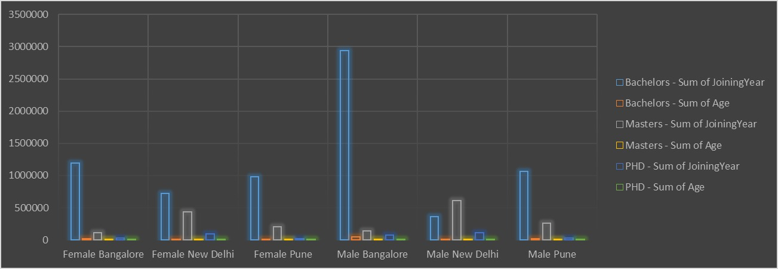
RESULTS
11

Slide 12
conclusion
1. Identify Gender Disparities
2. Understand Root Causes
3. Implement Targeted Intiatives
4. Continuous Monitoring and Evaluation

